Slide 1
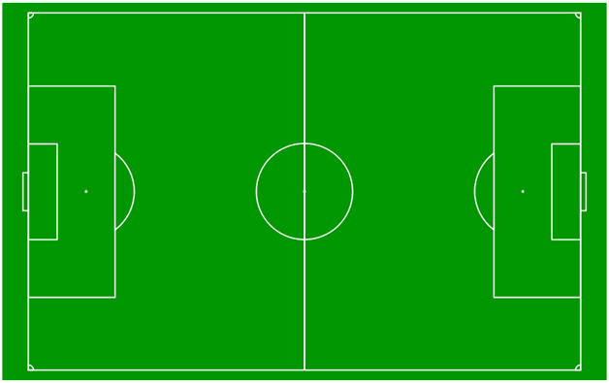



GROUP - 2
DEMOGRAPHIC
CORRELATION
MATRIX
SCATTERPLOT
PREFERRED FOOT
INTRO
CONCLUSION
AVG HEIGHT
FACETED SCATTERPLOT
WORDCLOUD
VARIANCE

Slide 2
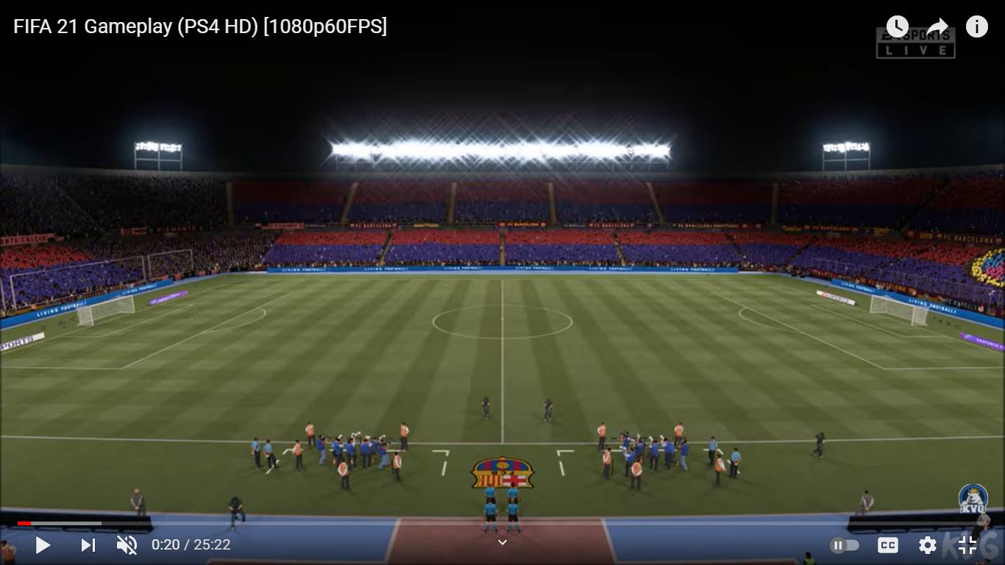

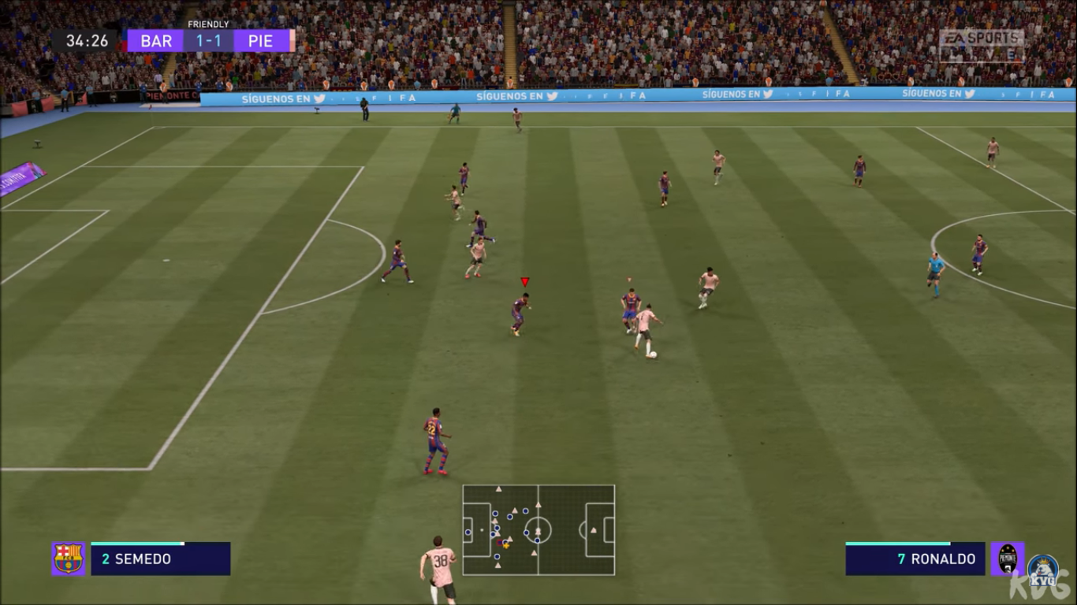
SOFTWARE
OBJECTIVES
METHODS USED FOR DATA ANALYSIS
1. TEST FOR SINGLE POPULATION MEAN.
1. TO UNDERSTAND THE DIFFERENT ATTRIBUTES OF A FIFA PLAYER.
R
TABLEAU
2. TEST FOR SINGLE POPULATION VARIANCE.
INTRODUCTION
3. EXACT BINOMIAL TEST
2. CHECK FOR PATTERNS IN DATA FOR DIFFERENT ATTRIBUTES THAT ARE PRESENT IN A FIFA PLAYER
4. KARL PEARSON’S CORRELATION MATRIX
5. VISUALISATING USING SCATTER PLOTS AND HISTOGRAM
3. TO TEST FOR CLAIMS ABOUT FIFA PLAYERS.
6. FACETED SCATTERPLOT
*DATA WAS OBTAINED FROM KAGGLE
501 SHARWARI

Slide 3
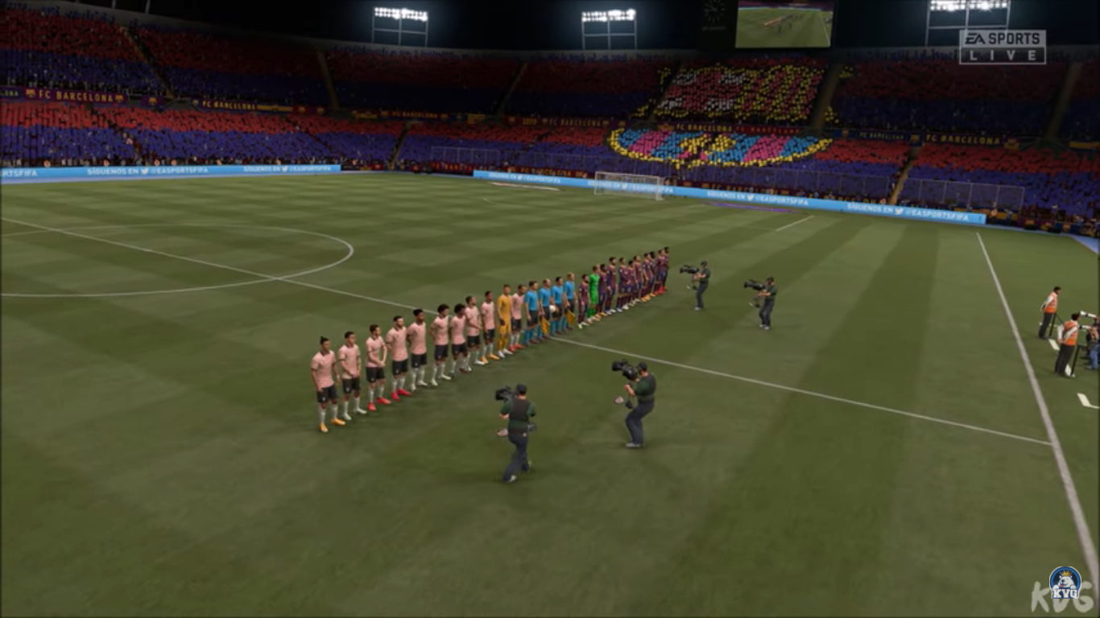
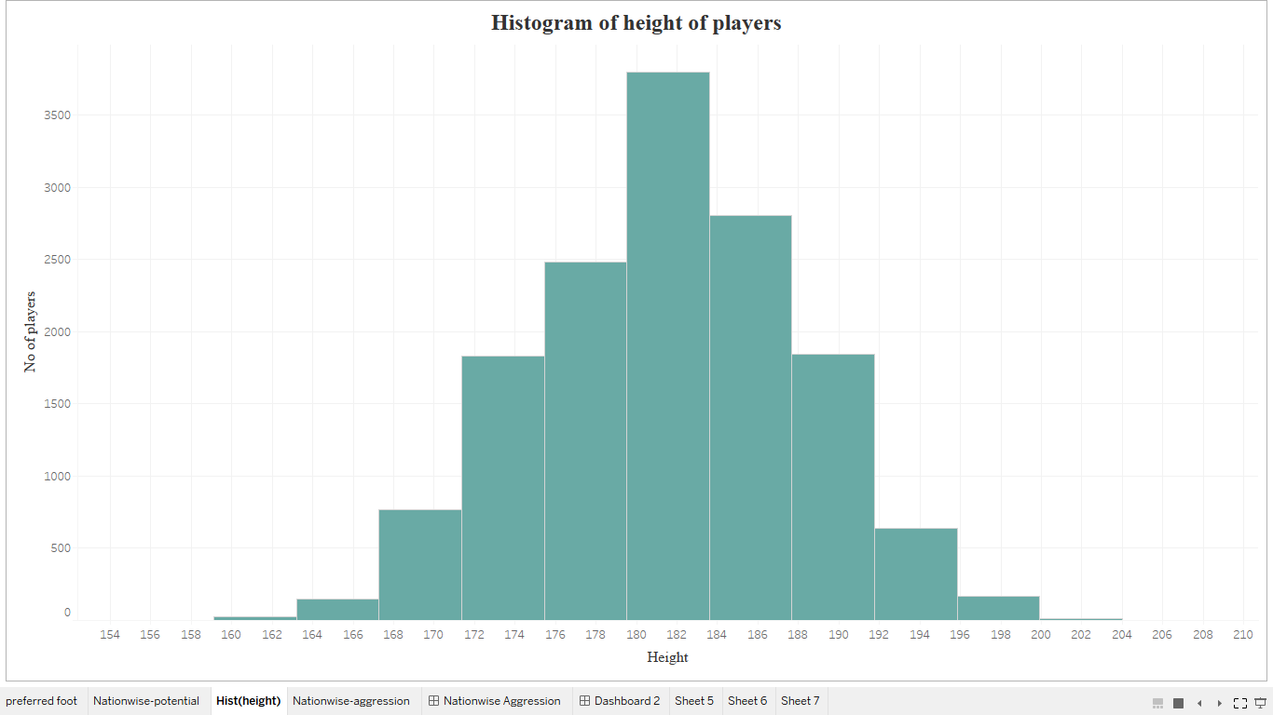
DEMOGRAPHICS
HEIGHT
OF
FIFA PLAYERS
473 ONKAR

Slide 4
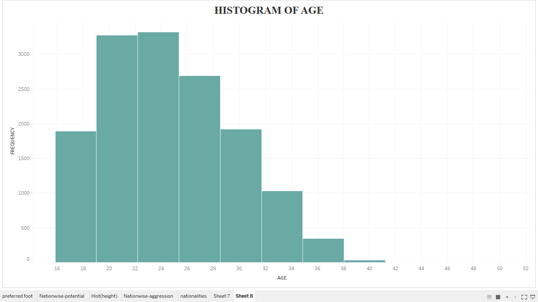
DEMOGRAPHICS
AGE
OF
FIFA PLAYERS
473 ONKAR

Slide 5

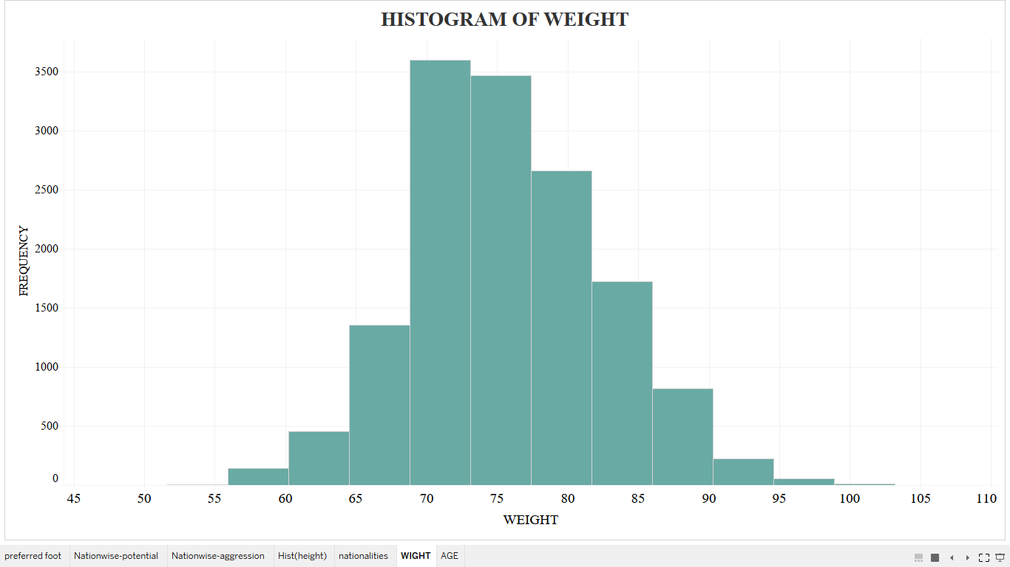
DEMOGRAPHICS
WEIGHT
OF
FIFA PLAYERS
473 ONKAR

Slide 6
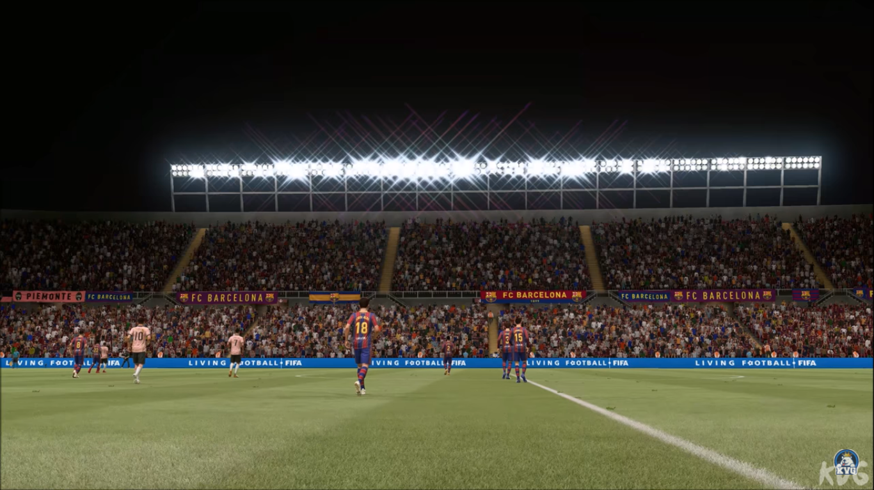
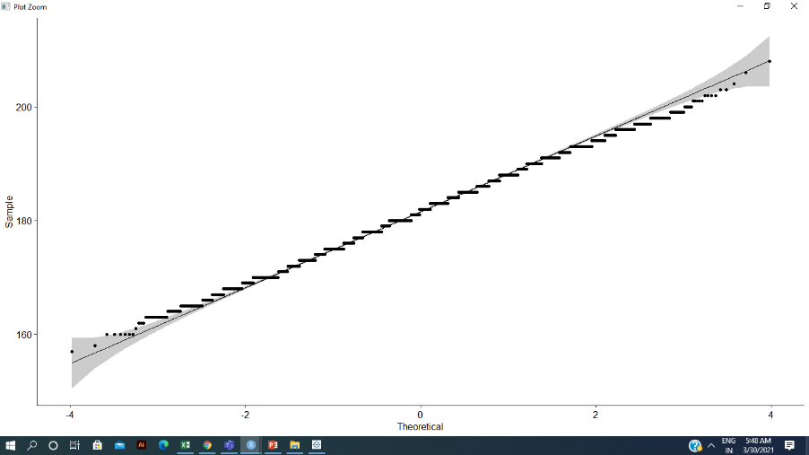
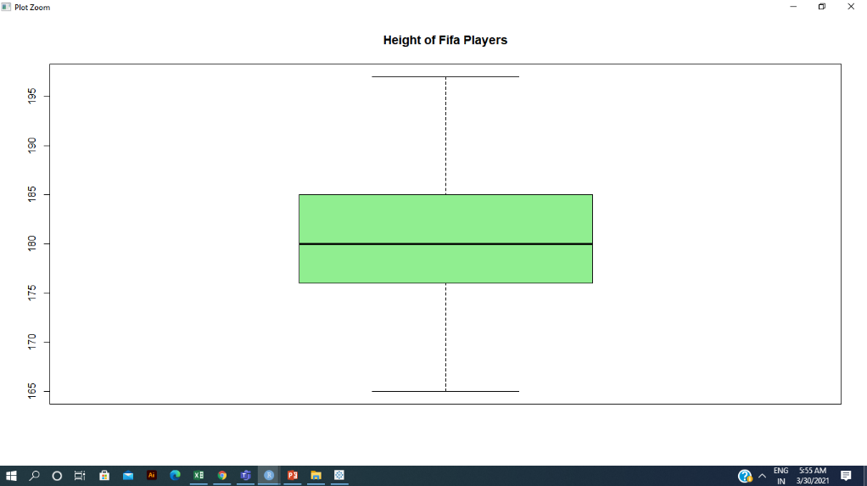
TO TEST THE SIGNIFICANCE OF SINGLE POPULATION MEAN
ASSUMPTION
FOOTBALL OBSERVATORY CLAIMS:
THE HEIGHT OF A FIFA PLAYER ON AN AVERAGE IS 181.7 CM
1. DEPENDENT VARIABLE IS CONTINOUS
2. OBSERVATIONS ARE INDEPENDENT IN NATURE.
3. DEPENDENT VARIABLE ‘HEIGHT’ COMES FROM A NORMAL POPULATION.
4. DEPENDENT VARIABLE DOES NOT CONTAIN ANY OUTLIER
482 INSHA

Slide 7

TO TEST THE SIGNIFICANCE OF SINGLE POPULATION MEAN
INTERPRETATION
T-TEST
FOOTBALL OBSERVATORY CLAIM’S THE AVERAGE HEIGHT OF FIFA PLAYER ON AN AVERAGE IS 181.7 CM IS NOT TRUE AT 5 % LEVEL OF SIGNIFICANCE
H₀ : μ₀=181.7
v/s
H₁ : μ≠181.7
AVG HEIGHT OF FIFA PLAYERS IS 181.7
AVG HEIGHT OF FIFA PLAYERS IS NOT 181.7
p-value < 2.2e-16
REJECT H₀
ACCEPT H₁
LEVEL OF SIGNIFICANCE= 0.05
482 INSHA

Slide 8
TO TEST THE SIGNIFICANCE OF SINGLE POPULATION VARIANCE
ASSUMPTION
CLAIM: VARIANCE OF HEIGHT OF FIFA PLAYERS IS 30
1. DEPENDENT VARIABLE IS CONTINOUS
2. DEPENDENT VARIABLE ‘HEIGHT’ COMES FROM A NORMAL POPULATION.
501 SHARWARI

Slide 9

TO TEST THE SIGNIFICANCE OF SINGLE POPULATION VARIANCE
CHI-SQUARED
INTERPRETATION
H₀ : 𝜎₀ ² =30
v/s
H₁ : 𝜎 ² > 30
VARIANCE OF HEIGHT OF FIFA PLAYERS IS GREATER THAN 30 AT 5 % LEVEL OF SIGNIFICANCE
VARIANCE OF HEIGHT OF FIFA PLAYERS IS 30
VARIANCE OF HEIGHT OF FIFA PLAYERS IS NOT 30
p-value < 2.2e-16
REJECT H₁
ACCEPT H₀
LEVEL OF SIGNIFICANCE= 0.05
501 SHARWARI

Slide 10
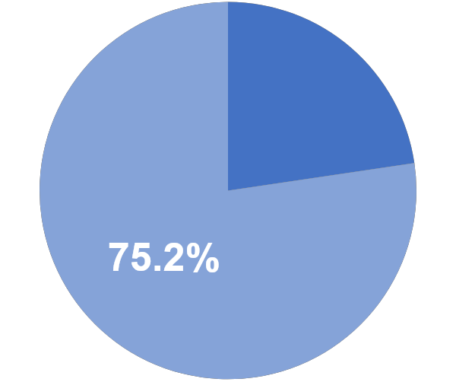
TO TEST THE SIGNIFICANCE OF SINGLE PROPORTION
ASSUMPTION
CLAIM: PENN STATE UNIVERSITY CLAIMS THAT 75% OF FIFA PLAYES PREFER THEIR RIGHT FOOT
1. THE SAMPLE IS A FAIR REPRESENTATION OF THE POPULATION.
24.8%
2. ITEMS ARE DICHOTOMOUS
3. SAMPLE ITEMS ARE INDEPENDENT
481 DHRITI

Slide 11

TO TEST THE SIGNIFICANCE OF HYPOTHETHICAL
POPULATION PROPORTION
CHI-SQUARED
INTERPRETATION
H₀ : p₀ ² =0.75
v/s
H₁ : p ≠ 0.75
PROPORTION OF FIFA PLAYERS WHO PREFER THEIR RIGHT FOOT IS 0.75 AT 5 % LEVEL OF SIGNIFICANCE
PROP OF FIFA PLAYERS WHO PREFER THEIR RIGHT FOOT IS 0.75
PROP OF FIFA PLAYERS WHO PREFER THEIR RIGHT FOOT IS 0.75
p-value = 0.2248
ACCEPT H₀
REJECT H1
LEVEL OF SIGNIFICANCE= 0.05
481 DHRITI

Slide 12
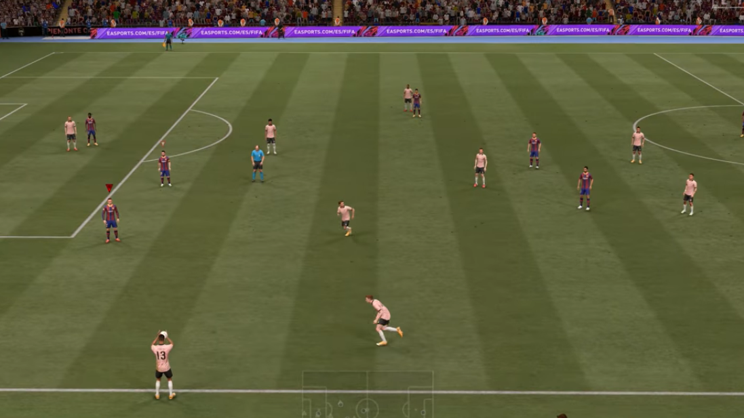
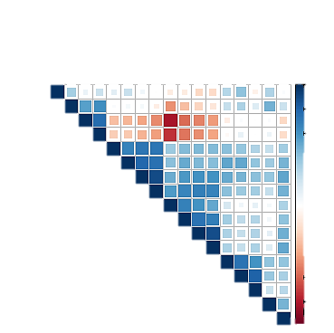
KARL PEARSON’S CORRELATION MATRIX
BALL CONTROL
ACCELERATION
SPRINTSPEED
AGGRESSION
PENALTIES
POTENTIAL
STRENGTH
DRIBBLING
REACTIONS
HEIGHT
BALANCE
OVERAL
STAMINA
WEIGHT
AGILITY
WE PERFORMED CLUSTER ANALYSIS TO KARL PEARSON’S CORRELATION MATRIX TO OBTAIN THE SIGNIFICANT RESULTS QUICKER.
AGE
VISION
AGE
1
STRENGTH
HEIGHT
WEIGHT
PENALTIES
VISION
BALL CONTROL
DRIBBLING
0
BALANCE
AGILITY
ACCELERATION
SPRINTSPEED
Vision v/s Ball control
Dribbling v/s Acceleration
Ball Control v/s Reaction
REACTIONS
OVERAL
POTENTIAL
Reaction v/s Vision
Sprint Speed v/s Stamina
Strength v/s Aggression
AGGRESSION
STAMINA
-1
481 DHRITI

Slide 13
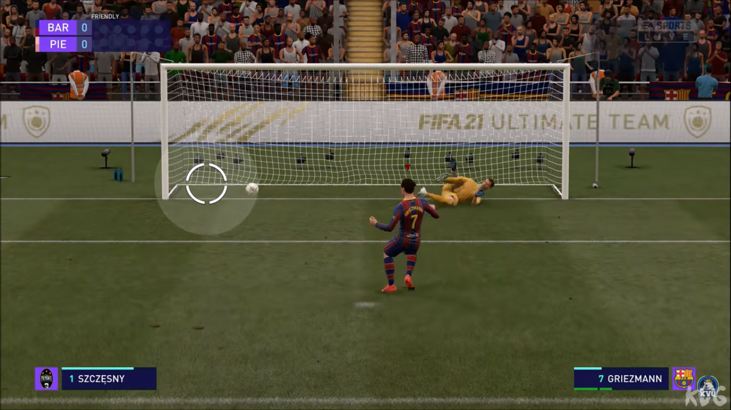
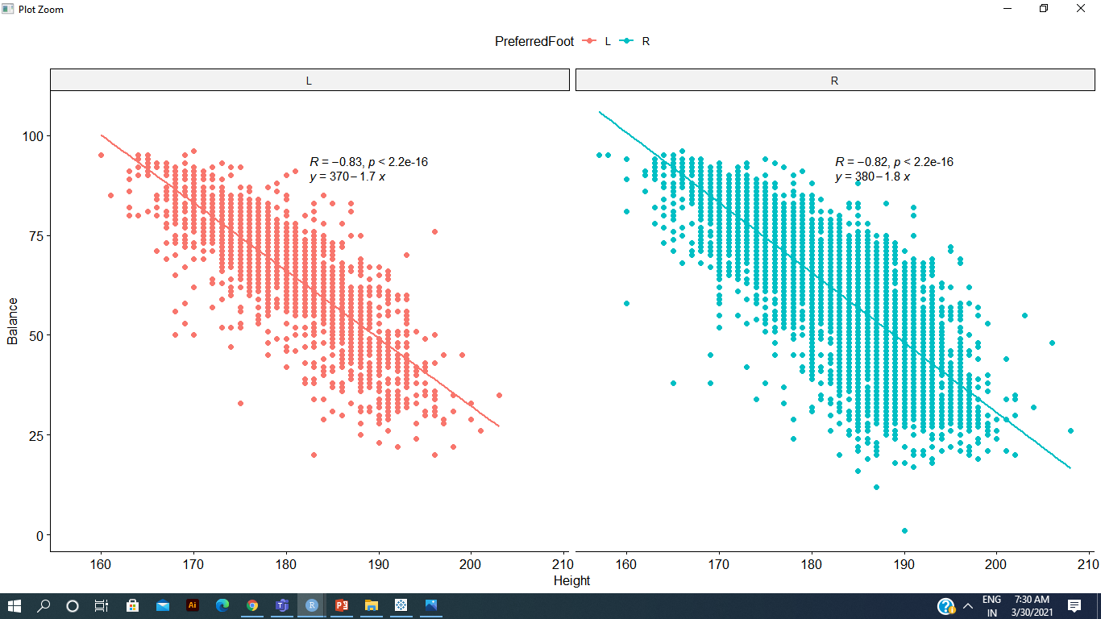
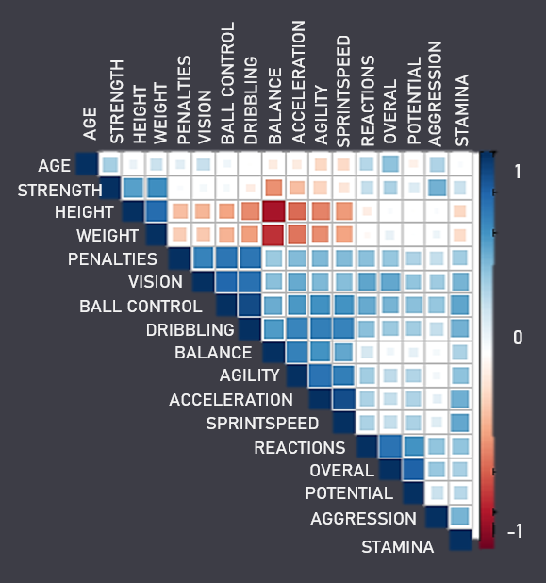
To check for Relationship based on Preferred Foot
483 Amaan

Slide 14
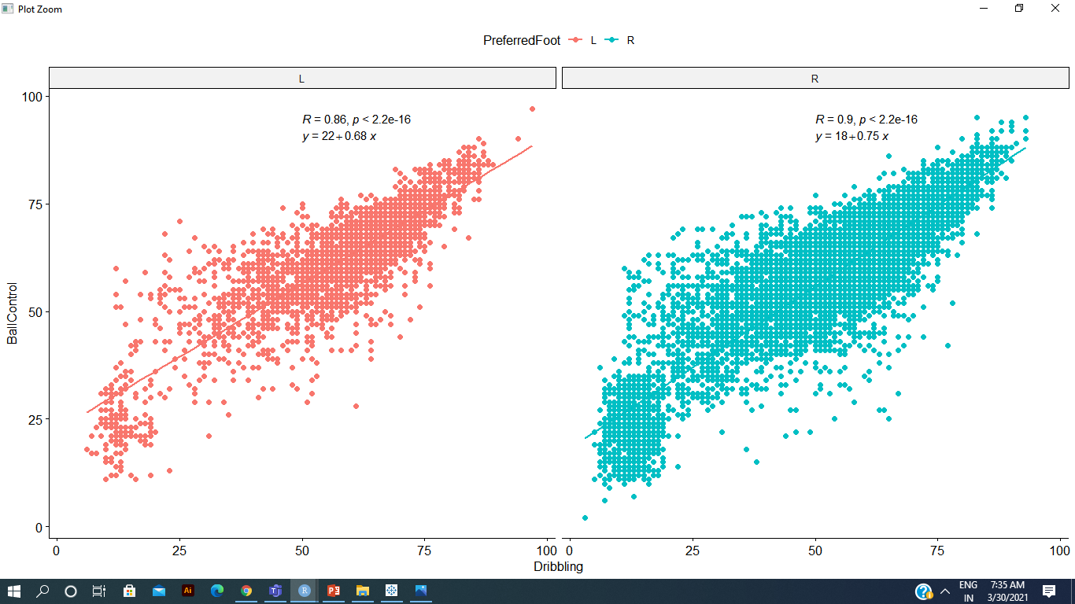
To check for Relationship based on Preferred Foot
483 Amaan

Slide 15
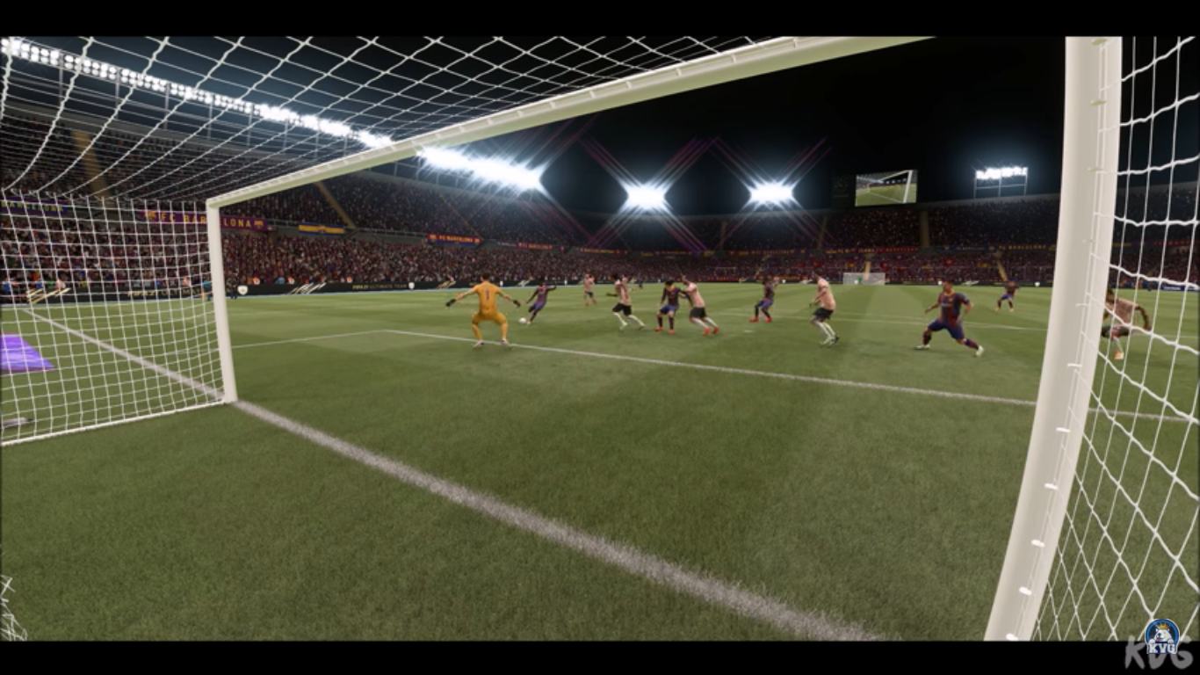
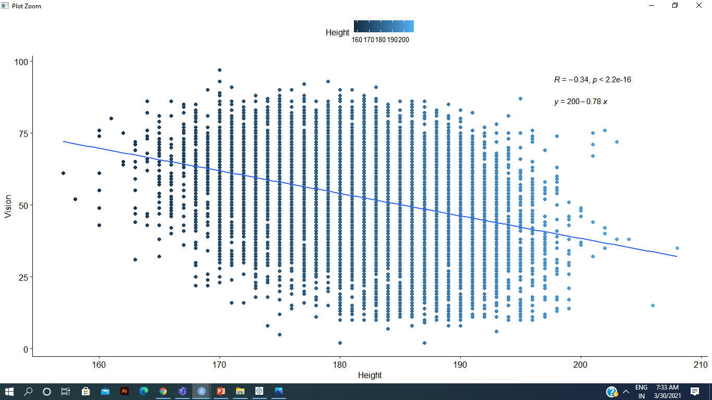
Height V/s Vision
461 Adith

Slide 16
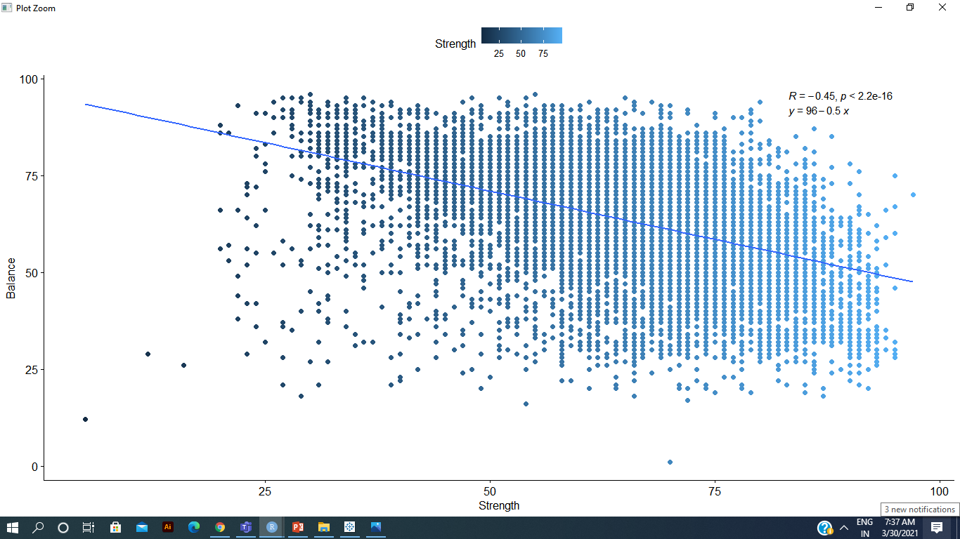
Strength V/s Balance
461 Adith

Slide 17
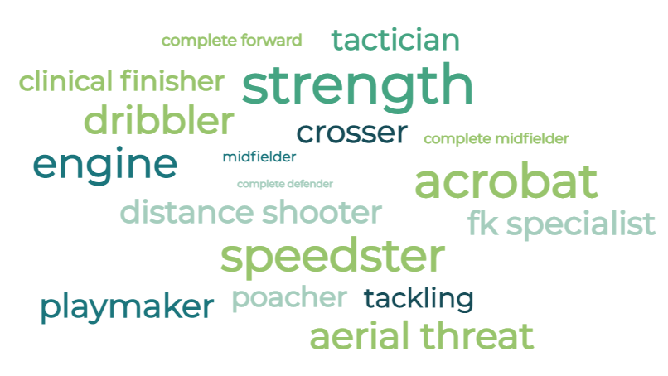
461 Adith

Slide 18
Match Summary
1. Stamina, Reaction, Vision, Ball control, Balance of height and weight are the key attributes in FIFA Players.
2. The average height of the players turned out to be lesser than 181.7 cm
3. 75% of the FIFA players prefer to use their right foot.
4. Variance of Avg Height of Players is greater than 30.
5. There is an unusual negative linear relationship between Height and Vision.

